Slide 1
1. Exams
2. Sampling Distributions
3. Estimation + Confidence Intervals

Slide 2
INFERENTIAL STATISTICS
  Samples are only estimates of the population
  Sample statistics will be slightly off from the true values of its population’s parameters
    Sampling error:
      The difference between a sample statistic and a population parameter
  Probability theory
    Permits us to estimate the accuracy or representativeness of the sample

Slide 3
The “Catch-22” of Inferential Statistics
  When we collect a sample, we know nothing about the population’s distribution of scores
    We can calculate the mean (x-bar) & standard deviation (s) of our sample, but μ and σ are unknown
    The shape of the population distribution (normal or skewed?) is also unknown

Slide 4
Probability Theory Allows Us To Answer:
What is the likelihood that a given sample statistic
accurately represents a population parameter?
Sample
N = 150
Sample
N = 300
μ = ? (N= A Bunch)
σ = ?
X=10.0
s = 5
p = .10
Number of serious crimes committed in year prior to prison for inmates entering
the prison system
P = ? (N= Millions)
Americans who plan to vote for Ron Paul for president in 2012
POPULATIONS
(All elements)
and their parameters

Slide 5
Sampling Distribution
(a.k.a. “Distribution of Sample Outcomes”)
  “OUTCOMES” = proportions, means, etc.
  Hypothetical, based on infinite random sampling, a mathematical description of all possible sampling event outcomes
    And the probability of each one
  Permits us to make the link between sample and population…
    Answer the question: “What is the likelihood that a sample finding accurately reflects the population parameter?”

Slide 6
Sampling Distributions
Many sampling distributions are “normal”
  Sample proportions and sample means
  Central Limit Theorem:
    Regardless of the shape of a raw score distribution (sample or population) of an interval-ratio variable, the sampling distribution will be approximately normal, as long as sample size is ≥ 100
    This allows us to use z-scores to figure out standard errors
      +/- 1.96 z-scores on a normal distribution will always include 95% of outcomes

Slide 7
    Sampling Distributions: Central tendency
  Sample outcomes (means, proportions, etc.) will cluster around the population outcomes
  Since samples are random, the sample outcomes should be distributed equally on either side of the population outcome
    The mean of the sampling distribution for sample means (a bunch of x’s) is always equal to the population mean (μ)
    The mean of the sampling distributions for proportions (infinite number of sample p’s), is equal to the population value Pμ

Slide 8
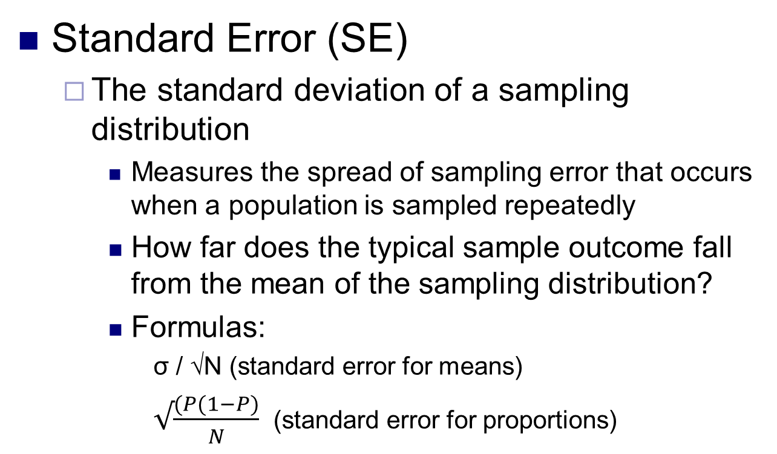
Sampling Distribution: Dispersion
Standard Error (SE)
  The standard deviation of a sampling distribution
    Measures the spread of sampling error that occurs when a population is sampled repeatedly
    How far does the typical sample outcome fall from the mean of the sampling distribution?
    Formulas:
      σ / √N (standard error for means)
      $√\frac{(P(1−P)}{N}$ (standard error for proportions)

Slide 9
1. Estimation
ESTIMATION
Notes:
SPRING ’07, SOC 3155 CLASS #11
[LOGON TO NET:
POINT OUT SSR HW #2 IS NOW POSTED & IS DUE NEXT TUESDAY;
HW #3 IS DUE NEXT THURSDAY
[ANNOUNCEMENT: BRING BOOKS & CALCULATORS FOR NEXT TIME….]
TODAY’s material coincides with Chapter 7 of Healey.

Slide 10
Introduction to Estimation
Estimation procedures
  Purpose:
    To estimate population parameters from sample statistics
      Using the sampling distribution to infer from a sample to the population
  Most commonly used for polling data
  2 components:
    Point estimate (sample mean, sample proportion)
    Confidence intervals

Slide 11
Estimation
Point Estimate: Value of a sample statistic used to estimate a population parameter
Confidence Interval: A range of values around the point estimate
Point Estimate
Confidence Interval
.58
.546
.614
Confidence Limit (Lower)
Confidence Limit (Upper)

Slide 12
Estimation1 : Pick Confidence Level
  Confidence LEVEL
    Probability that the unknown population parameter falls within the interval
      Alpha (α)
        The probability that the parameter is NOT within the interval
        α is the odds of making an error
        Confidence level = 1 - α
    Conventionally, confidence level values are almost always 95%or 99%

Slide 13
Procedure for Constructing an Interval Estimate
2. Divide the probability of error equally into the upper and lower tails of the distribution (2.5% error in each tail with 95% confidence level)
  Find the corresponding Z score
0.95
.025
.025
-1.96
← Z scores →
1.96

Slide 14
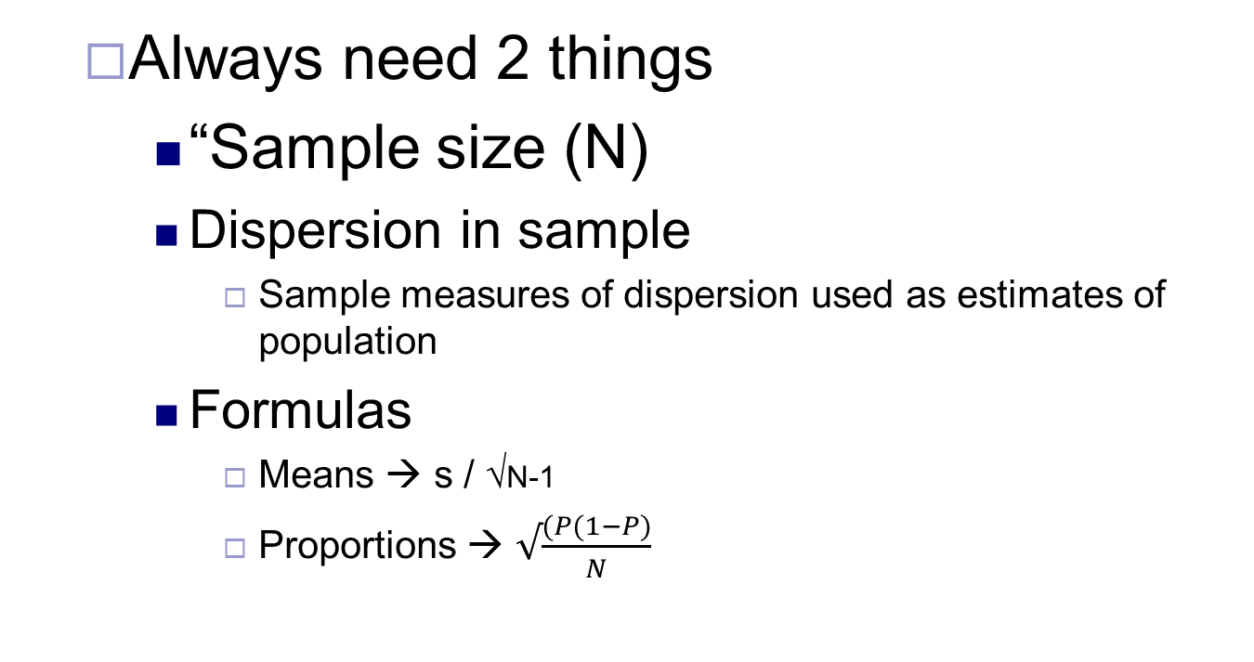
Calculate the Standard Error Based on Your Sample
  Always need 2 things
    “Sample size (N)
    Dispersion in sample
      Sample measures of dispersion used as estimates of population
    Formulas
      Means → s / √N-1
      Proportions → $√\frac{(P(1−P)}{N}$

Slide 15
Putting it all Together
What is point estimate?
  Proportion, mean
  Build confidence interval around this
Calculated Standard Error
  What is one standard error worth?
How many Standard Errors to “go out”
  Based on α/C.L. (e.g., 95% CL = .05 alpha)
    1.65 = 90% CL
    1.96 SE = 95% CL
    2.58 SE = 99% CL

Slide 16
Confidence intervals for proportions
A random sample of American votesrs found done by Maahs Associates found that 25% of Americans would elect a Satanist to be president (N = 200).
  Point estimate = .25
  Sample size (N) = 200
  Dispersion → p(1-p)
  Calculate for α = .05 and α = .01

Slide 17
Example 2
Houston Chronicle (2008) — A University of Texas poll to be released today of 550 registered voters found that 23 percent of Texans are convinced that Democratic presidential nominee Barack Obama is a Muslim.
    GIVEN THIS INFO, IDENTIFY A POINT ESTIMATE & CALCULATE THE CONFIDENCE INTERVAL (ASSUMING A 95% CONFIDENCE LEVEL).
    CALCULATE THE CONFIDENCE INTERVAL ASSUMING A 99% CONFIDENCE LEVEL

Slide 18
Estimation of Population Means
    EXAMPLE:
    A researcher has gathered information from a random sample of 178 households. Construct a confidence interval to estimate the population mean at the 95% level:
      An average of 2.3 people reside in each household. Standard deviation is .35.
Notes:
SO, WE’RE GONNA FOCUS ON EXAMPLES WHERE THE POP. S.D. IS UNKNOWN.
IN THESE CASES, WE USE s (SAMPLE STANDARD DEVIATION) AS A SUBSTITUTE FOR POPULATION STANDARD DEVIATION
HOWEVER, s IS A BIASED ESTIMATOR OF SIGMA. TO CORRECT FOR THIS BIAS, WE SUBTRACT 1 FROM N.
THIS IS THE FORMULA WE’LL BE FOCUSING ON.
SO FOR THIS WHOLE CHAPTER, THERE ARE ONLY 2 FORMULAS TO FOCUS ON. THE PROPORTIONS ONE AND THIS ONE.

Slide 19
CONSTRUCT CONFIDENCE INTERVALS
  A random sample of 429 college students was interviewed
      They reported they had spent an average of $178 on textbooks during the previous semester. If the standard deviation (s) of these data is $15 construct an estimate of the population at the 95% confidence level.
      They reported they had missed 2.8 days of class per semester because of illness. If the sample standard deviation is 1.0, construct an estimate of the population mean at the 99% confidence level.
  Two individuals are running for mayor of Duluth. You conduct an election survey of 100 adult Duluth residents 1 week before the election and find that 45% of the sample support candidate Long Duck Dong, while 40% plan to vote for candidate Singalingdon.
    Using a 95% confidence level, based on your findings, can you predict a winner?

Slide 20
What influences confidence intervals?
  The width of a confidence interval depends on three things
    α: The confidence level can be raised (e.g., to 99%) or lowered (e.g., to 90%)
    N: we have more confidence in larger sample sizes so as N increases, the interval decreases
    Variation: more variation = more error
      % agree closer to 50%
      Higher standard deviations

